Slide 1


Revolutionizing Productivity with AI Agents
Welcome to the future of work. Our AI Agents enhance productivity and efficiency. We are at the forefront of innovation.
by Venkat Reddy

Slide 2




What are AI Agents?
Perceive
Reason
Act
AI Agents observe their environment.
They process information and make decisions.
They execute actions to achieve goals.
AI Agents are autonomous entities. They perceive environments and act to achieve goals. Examples include smart assistants and automated customer service.

Slide 3

The Power of Autonomous Problem-Solving
30%
Efficiency Increase
Significant boost in task completion speed.
20%
Cost Reduction
Substantial savings from automation.
95%
Accuracy Rate
Minimizing errors in operations.
24/7
Availability
Continuous, uninterrupted operation.
AI Agents increase efficiency by 30%. They reduce costs by 20% and improve accuracy to 95%. They operate 24/7 without downtime.

Slide 4




Real-World Applications
Customer Service
Supply Chain
Healthcare
Finance
AI chatbots resolve 80% of inquiries efficiently.
Predictive maintenance reduces downtime by 15%.
AI diagnoses diseases with 90% accuracy.
Fraud detection prevents over $1M in losses.
AI Agents revolutionize various sectors. They optimize customer service, streamline supply chains, enhance healthcare diagnostics, and strengthen financial security.

Slide 5
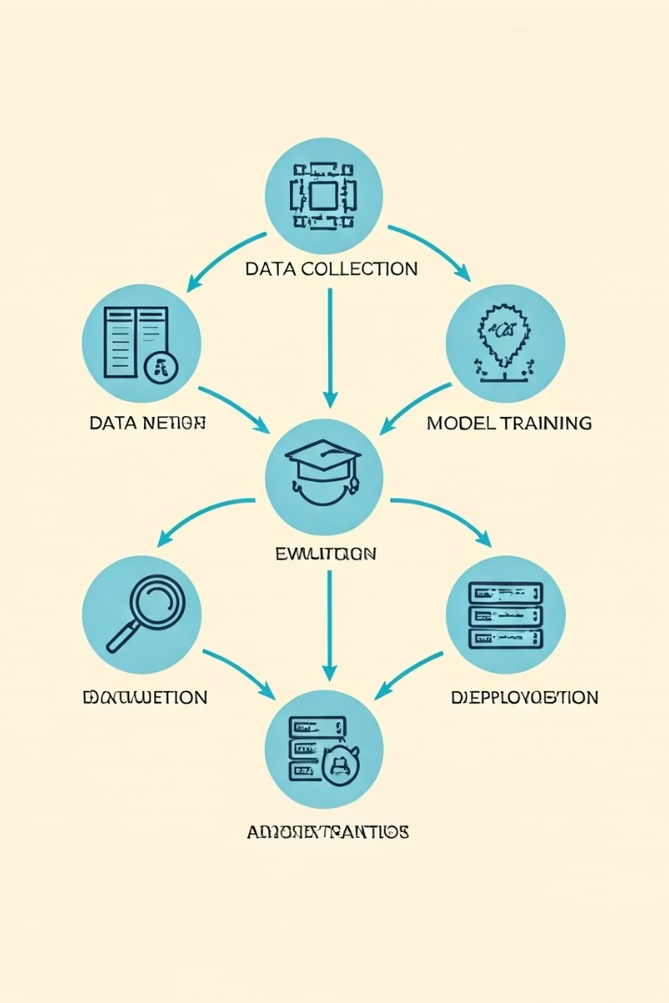




Our Approach to AI Agent Development
Explainable AI
We ensure transparency and build trust.
Reinforcement Learning
Our agents continuously improve over time.
Ethical AI
Data privacy and responsible AI are paramount.
Custom Solutions
Tailored to specific client needs and goals.
Our methodology focuses on explainable AI and continuous improvement. We prioritize ethical development and provide customized solutions for every client.

Slide 6

AI Agent Product Demo
Product: AlphaAgent
AlphaAgent automates complex workflows. It integrates seamlessly with existing systems. Experience faster, error-free operations.
2x faster task completion
99% accuracy in data processing
AlphaAgent is our flagship AI product. It excels in speed and accuracy. See it in action with a live demonstration.

Slide 7
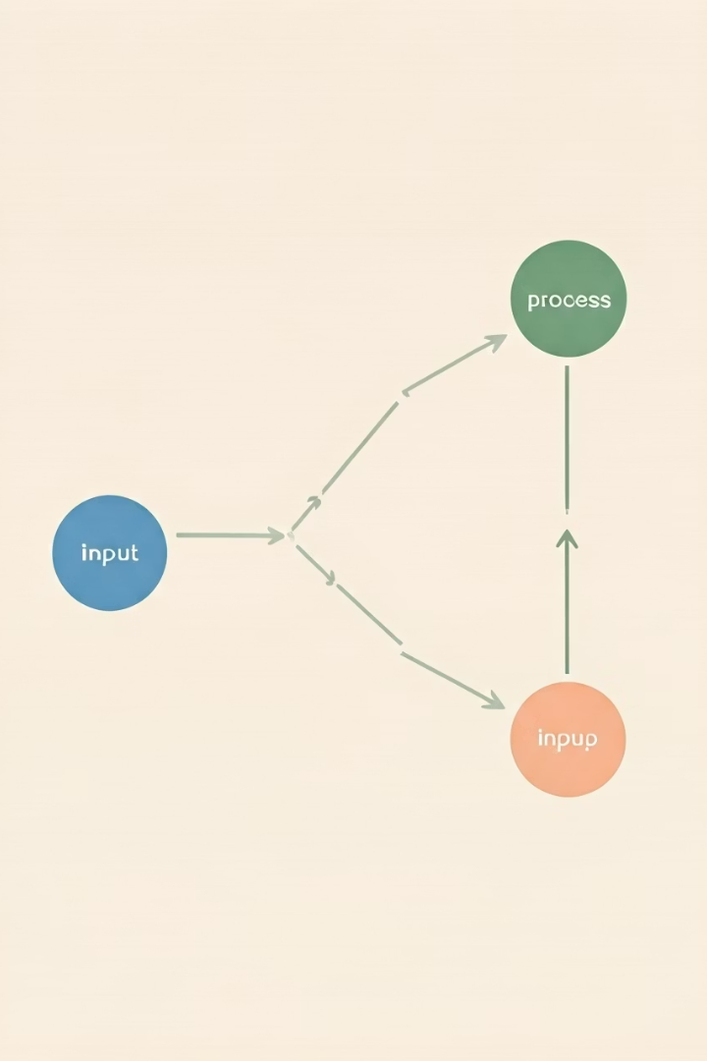




Implementation & Integration
Data Assessment
Preparing and refining your data.
Model Training
Training AI models for optimal performance.
System Integration
Seamlessly connecting with existing systems.
Ongoing Support
Continuous monitoring and assistance.
Our implementation process is designed for ease. We assess data, train models, integrate systems, and provide ongoing support. Minimal disruption guaranteed.

Slide 8

Next Steps: Partnering for the Future
Schedule a Consultation
Pilot Project
Demonstrate value with a proof-of-concept.
Explore your specific AI Agent opportunities.
Embrace AI
Unlock long-term benefits and sustained growth.
Let's discuss how AI Agents can transform your operations. Contact us today for a consultation or pilot project. The future is now.
Contact: info@yourcompany.com | Website: yourcompany.com

